Slide 1
UDP Custom Device Demonstration
For AImotive
Aaron Douglass
Applications Engineer – ADAS & Autonomy
Notes:
Cover option 2
Pick option based on your style.

Slide 2
Notes:
Mandatory slide to use to remind customers we are same com, Can be used in beginning or end based on your story.

Slide 3
Agenda
Today’s Agenda:
Quick Intro to Custom Devices
NI-AImotive HIL System Architecture
UDP-Data-Link Custom Device Overview
UDP-Data-Link Custom Device Demonstration
Conclusions
Questions & Next Steps
Notes:
Agenda Slide
Section title can be used as subhead but optional

Slide 4
Quick Intro to Custom Devices
Custom Device Use Cases:
3rd Party Hardware
Simulate Specialty Sensors
Custom Features
Communication Protocols
Waveform Signal Processing

Slide 5
Quick Intro to Custom Devices
Components of a Custom Device:
A custom device consists of at least two VI libraries (LLBs), Engine.llb and Configuration.llb, and an XML file that tells NI VeriStand how to load, display, use, and deploy the custom device.
Required Libraries:
Engine.llb
Configuration.llb
XML
Additional dependencies required for building UDP Data Link Custom Device:
OpenG Toolkit
VeriStand Data Library
NI VeriStand Development Tools
More…

Slide 6
Quick Intro to Custom Devices
Assess whether a custom device is the best option given needs and experience
Learn the custom device framework
Plan the custom device
Process for Developing a Custom Device:
Implement custom device
Debug and benchmark custom device
Build and distribute custom device

Slide 7


NI-AImotive HIL System Architecture
High Performance Computer
NI Linx Real-Time (PXI)
UDP

Slide 8
UDP Data Link Custom Device Overview
Purpose: To extend VeriStand's communication abilities by providing the user with the ability to transmit and receive UDP packets
Features
Import and export UDP Custom Device configurations
Define Transmit and Receive packets
Map VeriStand channels to UDP packets
Specify packet data, port, and channel configuration information in VeriStand
Import and export channel configurations using csv files

Slide 9
UDP-Data-Link Custom Device Demonstration
Notes:
There are 3 options for divider slide.
This one is with when you have less text, if only using Header and not subhead the text font size can be bumped up to 48pt size.
Divider Slide for Less Text
Prefer 25
Lines seem unfinished, with different colors, and the texture seems like too much
The green graphic needs to be very simple when so large on a slide.
Leaning towards Slide 25….

Slide 10
Questions & Next Steps
Outstanding Questions:
What are the next steps for this project?
Next Steps:
Install build UDP Data Link custom device from NI Package Manager to test existing functionality
Build UDP Data Link Custom Device from source code
Implement required changes to custom device

Slide 11
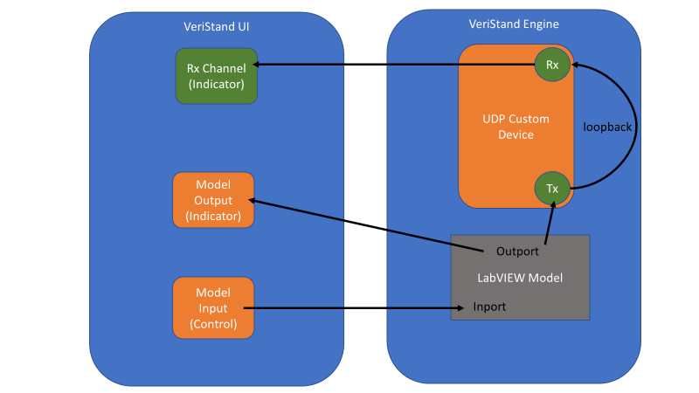

Slide 12
VeriStand UI
VeriStand Engine
Output from Model
Model
VeriStand
UDP Channels
Inport
Outport
Input to Model
UDP
Custom
Device
Rx
CSV with Channel Info
(See example)
Tx
VeriStand
UDP Channels
LabVIEW UDP Code
Tx
Rx
Notes:
R&D has serialization/deserialization VIs that might help with sending data across flat buffers. This helps with connecting with C# and other programming languages. Google Protobuf.

